Slide 1
AUTOMATIC DETECTION OF DIABETIC RETINOPATHY
Under the guidance of Dr. Himadri Sekhar Dutta
Presented by :
Kanu Soren
Joydip Panja
Brijesh Mondal
Pranshu Chakraborty

Slide 2
DIABETIC RETINOPATHY
What is Diabetic Retinopathy?
♦ Diabetic Retinopathy, abbreviated as DR, is the effect of Diabetics on eye which may lead to blindness in its furthermost stage.
♦ Symptoms: Some patients may have blurred vision, certain loss of vision, smoke globes or specks that float in front of the eye.
Notes:
Overall one may not have experience about any symptoms. Retina
screening may pick up early warning in the science of which we are unaware. This is the main reason
of why it is so important to attend regular screening appointments without any experience
of the symptoms.

Slide 3
Motivation
What is the effect of it now-a-days?
♦ Diabetes is in its epidemic form now a days. All patients with diabetes mellitus have a higher risk of being diagnosed with diabetic retinopathy. In Singapore & India like third world countries, 22% of patients are diagnosed with diabetic retinopathy and half of this affected patients had severe sight-threatening diseases.

Slide 4
BASIC EYE ANATOMY
Notes:
This is the basic anatomy of the eye. We all know that light comes through the lens & falls on the retina to make things outside of the world visible. Iris another main part of the eye used to control the light flow into the eye. Rod & cones cells presented in retina helps us to view & enjoy the scenes.

Slide 5
DIABETIC Retinopathy
Effect of diabetes on the eye is called Diabetic
Retinopathy (DR).
It can be mainly classified into two categories.
Non-Proliferative or Background Diabetic Retinopathy (N-PDR or BDR)
Proliferative Diabetic Retinopathy (PDR)
Notes:
Non-proliferative diabetic retinopathy occurs when there are only intraretinal microvascular changes, such as altered retinal vascular permeability and eventual retinal vessel closure.
However, in advanced NPDR, nonperfusion of the retina may develop and lead to the proliferative phase. Proliferative diabetic retinopathy is characterized by new vessels and sometimes fibrous bands proliferating on the retinal surface.
In both nonproliferative and proliferative
diabetic retinopathy, macular edema can occur as increased retinal vascular permeability leads to accumulation of fluid in the retinal area serving central vision.

Slide 6
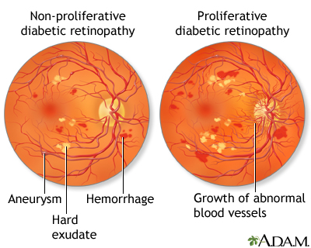
Background diabetic retinopathy
Earliest stage of Diabetic Retinopathy
Blood vessels get weakened.
Lead to dot like bleeding known as microaneurysm.
No surgical operations are needed.
Monitoring & Controlling Blood Pressure
can be helpful.
Also known as Non-proliferative Diabetic Retinopathy (NPDR)

Slide 7
Proliferative DIABETIC Retinopathy
Circulation problem in the blood vessels
New fragile vessels developed
These self-developed vessels can
hemorrhage easily leading to blood
leaking into humour which causes blots
& decreases the quality of the vision.
In Maculopathy, macula is affected by exudates. Exudates generation too close to the macula damages the central vision & may lead to permanent loss of vision.
Notes:
Circulation problem in the blood vessels of the retina mean some areas don’t get enough oxygen. New fragile vessels formed to bring in this vessels oxygen. Since this new vessels are self-developed , they can hemorrhage easily leading to blood leaking to retina which causes floats & decreases the quality
of the vision. Laser will be used to shrink these.
Maculopathy & its effects are quite different. It effects the central part of the retina called the macula which is mainly responsible for the
sharp vision. This fluid is caused due to damaged blood vessels of the retina & is rich in fat & cholesterol. Over the eye re-absorbs the water easily. The fat & the cholesterol leaves behind as residue called as exudates. These are seen into the photograph as yellow blobs around the area of fluid leakage. If
the fluid accumulates too close to the center of the macula then the central vision maybe destroyed. If too much of the exudates accumulate around the macula then it may cause to permanent loss of central vision. To prevent this lasers are used by the ophthalmologists. If one can keep his/her Blood pressure & glucose level accordingly to as recommended by the doctor then he/she is less likely to be in such a problems.

Slide 8
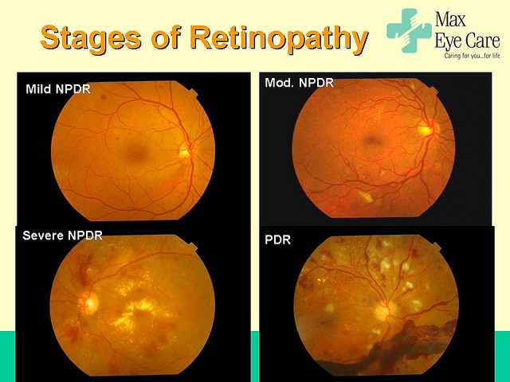
STAGES OF RETINOPATHY

Slide 9
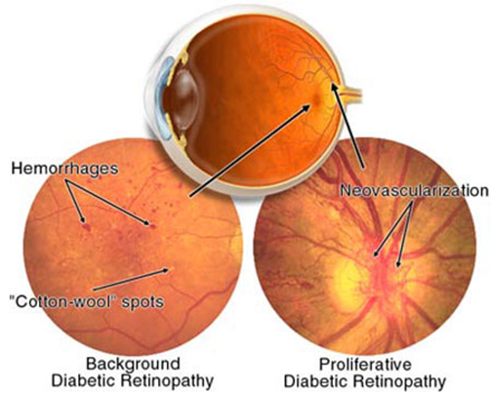
ABNORMALITIES ASSOCIATED WITH EYE
Microaneurysms
Haemorrhages
Hard Exudates
Soft Exudates
Neovascularization

Slide 10
OUR AIM OF THE PROJECT
Blood vessels are extracted in this project for the identification of diabetic retinopathy. The amount of blood vessel area in DR affected eye is much higher than normal eye because of Neo-vascularization.
Affected
Normal

Slide 11
Image processing

Slide 12
Stages of Blood vessel Detection
Fundus Image
(RGB)
Green Component
Intensity Inversion
Histogram
Equalization
Optical Disk Removal
Noise Removal
Border Removal
Blood vessel
area calculation
Image Segmentation

Slide 13
What is an image?
We can think of an image as a function, f(x,y)
f( x, y ) gives the intensity at position ( x, y )
Realistically, we expect the image only to be defined over a rectangle, with a finite range:
f: [a,b]x[c,d] → [0,1]
A color image is just three functions pasted together. We can write this as a “vector-valued” function:
Notes:
As opposed to [0..255]

Slide 14
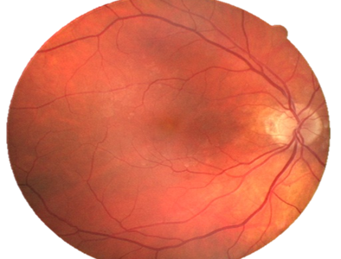
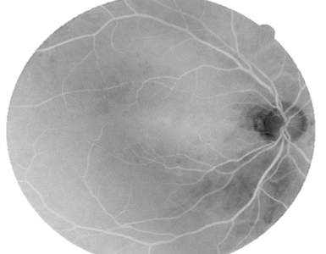



INTENSITY INVERSION
♦The intensity of the green channel of Fundus Image is inversed. ♦ Green channel is used as it is more efficient in the detection.

Slide 15
ADAPTIVE HISTOGRAM EQUILIZATION (CLAHE)
What is adaptive histogram equalization ?
Adaptive histogram equalization (AHE) is a computer image processing technique used to improve contrast in images.
What is CLAHE ?
CLAHE differs from ordinary adaptive histogram equalization in its contrast limiting. This feature can also be applied to global histogram equalization .

Slide 16
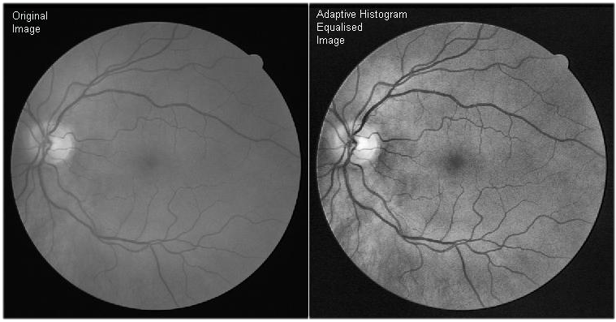
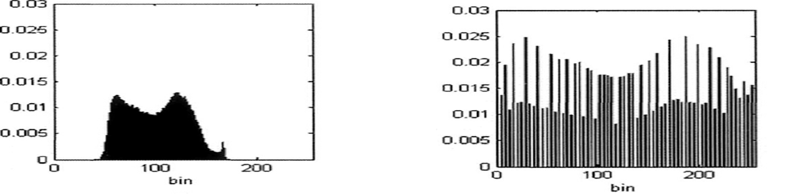
CLAHE result:

Slide 17
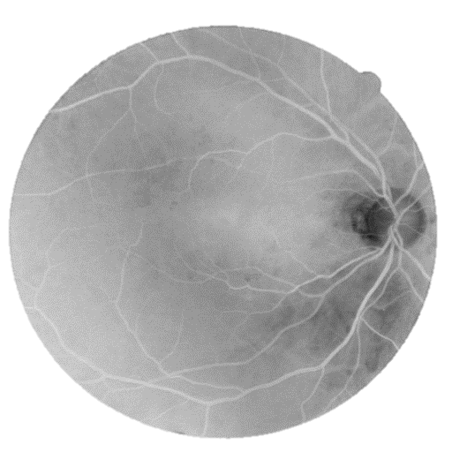
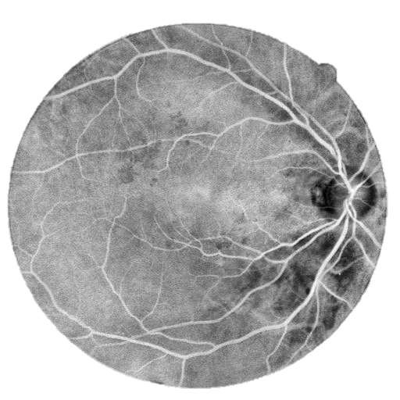
Histogram Equalization
♦ Contrast of the fundus image tends to be bright in the centre and diminish at the side. ♦ To minimize this & have more uniform image contrast is stretched by applying adaptive histogram equalization.
Inversed Green Channel
CLAHE Output

Slide 18

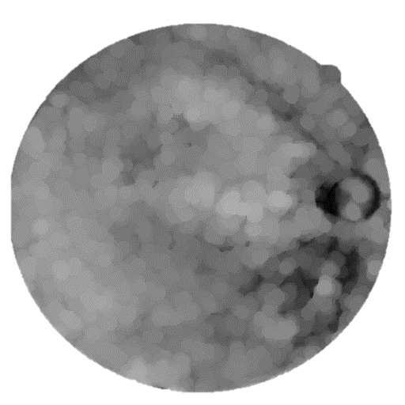
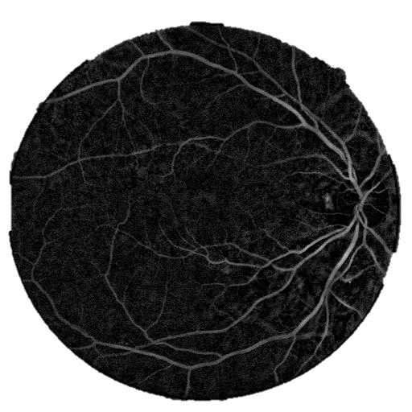
Optical Disk Removal:
♦ Optical disk is a black patch in the image. ♦ Erode function protects the small blood vessels by reducing their sizes while dilate function blows up the larger remaining details which are intended to be removed. ♦ Optical disk is then removed by Subtracting the resulting image from the CLAHE Output image.
Opening

Slide 19
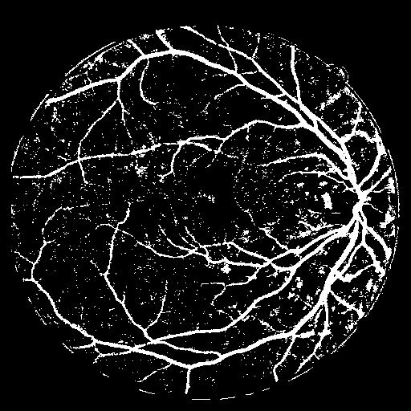
Image segmentation:
♦ Image segmentation is also the process of selecting of pixels that are similar in characteristics such as intensity & connectivity. ♦ Image segmentation is used to locate the boundaries of vessel in the Fundus image.

Slide 20
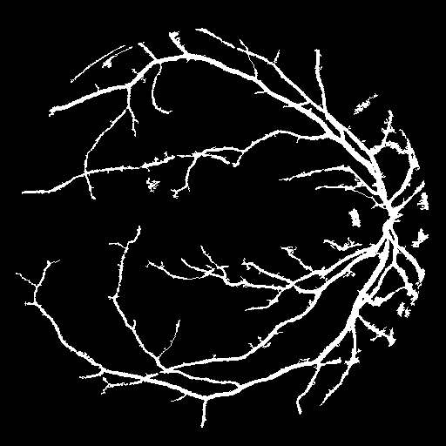
Noise Removal:
♦ After segmentation, the binary image becomes noisy.. ♦ We marked all connected clusters & calculate the pixel-area of the cluster. smaller than a particular value, considering them as noise. ♦ Pixel areas smaller than a particular threshold value are deleted, considering them as noise.

Slide 21


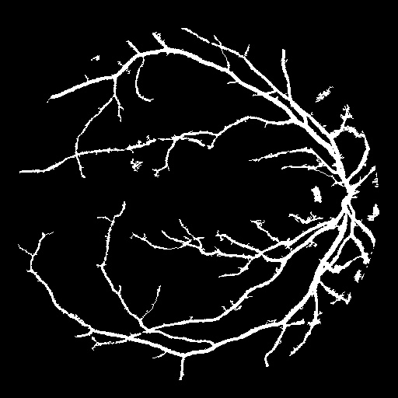
Border Removal: ♦ The Circular border creates some noise pixels. ♦ We used canny method to detect the edges & image filling is done to fill the region. ♦ The Circular border is obtained after subtracting the dilated image with the eroded image,which is subtracted from the noise removed image.
Blood vessel count ♦ The area of the blood vessels is obtained by using two loops to count
number of pixels with binary 1 (white) in the final blood vessel image.

Slide 22
MATLAB IMPLEMENTATION
We implemented the basic pre-processing stages by Matlab programming on MATLAB vR2013a. As we know that the area of blood vessel increases proportionally with the effect of Diabetic Retinopathy, we have calculated the blood vessel area using matlab functions. Henceforth, the stage of the disease is detected.

Slide 23
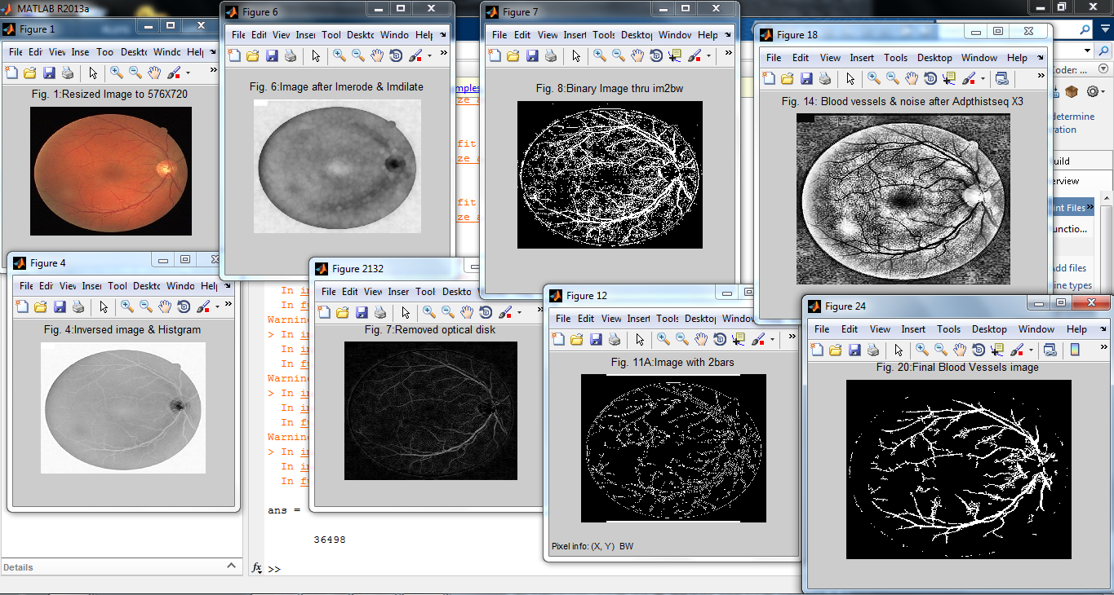

Slide 24
RESULT
♦ We took 40 Fundus images. Among which some
eyes are affected from different types of DR and
some are normal.
♦ We take the images as input & get the blood
vessel area as output.
♦ By knowing the types of DR of the images
previously we can easily understand the
corresponding Blood vessel area for that types of
DR.
Notes:
The criteria used for detecting image background based disease like exudates, microaneurysm and red
spots include Object Ratio Test, Compact Ratio Test, Length Test, Pixel Count Test
and Region Hole Test. After detecting and removing these background based
diseases, the image is then passed to the Vein-Processing stage for crossover points
detection using Modified Crosspoint Number Method (MCNM).

Slide 25
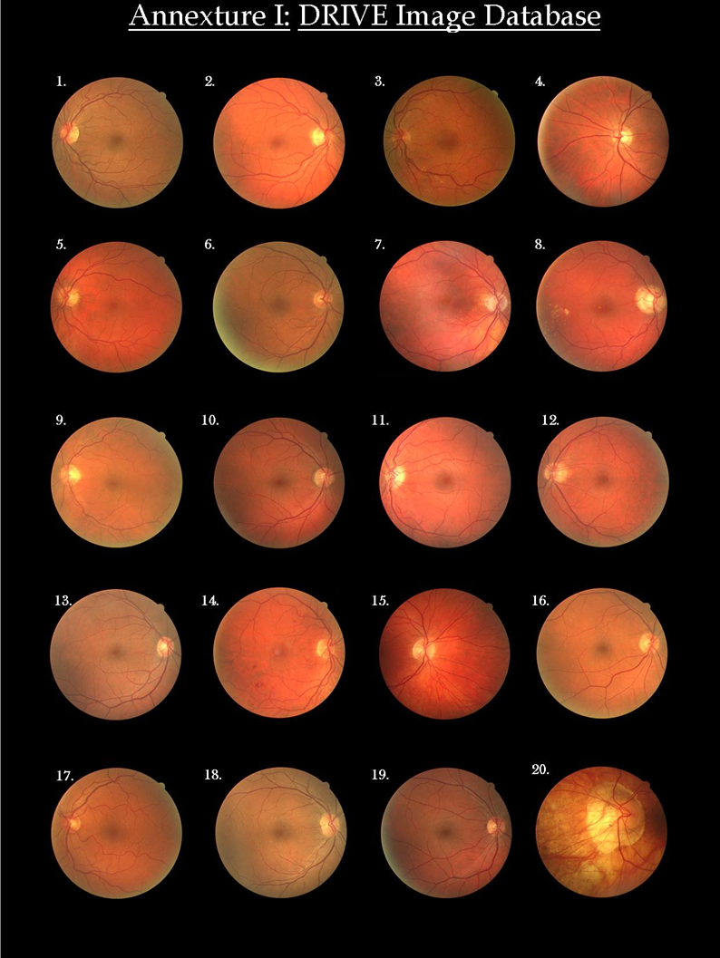
PRACTICAL RESULTS

Slide 26
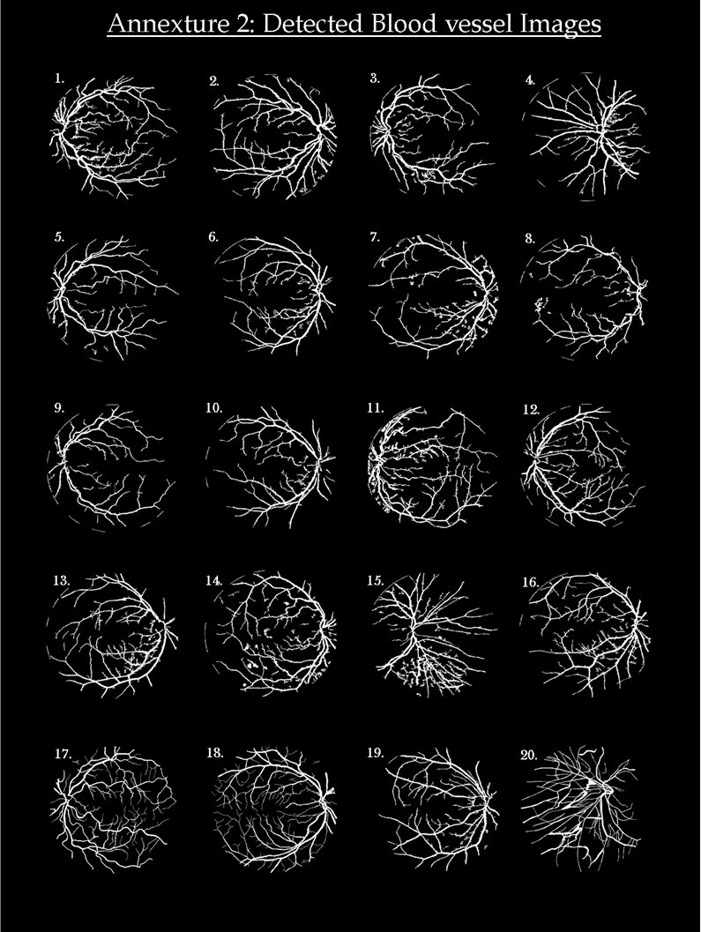

Slide 27
FUNDAS IMAGE NO | BLOOD VESSEL AREA | DR STAGE | FUNDAS IMAGE NO | BLOOD VESSEL AREA | DR STAGE
Image-1 | 24807 | Mild NPDR | Image-11 | 23740 | Mild NPDR
Image-2 | 24467 | Mild NPDR | Image-12 | 19467 | Normal Eye
Image-3 | 19491 | Normal Eye | Image-13 | 21006 | Normal Eye
Image-4 | 21144 | Normal Eye | Image-14 | 21586 | Normal Eye
Image-5 | 16954 | Normal Eye | Image-15 | 22519 | Mild NPDR
Image-6 | 25004 | Mild NPDR | Image-16 | 21057 | Normal Eye
Image-7 | 19707 | Normal Eye | Image-17 | 28412 | Moderate NPDR
Image-8 | 14787 | Normal Eye | Image-18 | 35611 | Moderate NPDR
Image-9 | 13753 | Normal Eye | Image-19 | 22867 | Mild NPDR
Image-10 | 17555 | Normal Eye | Image-20 | 51182 | PDR

Slide 28
CONCLUSION
♦ The first phase of the work we have mainly highlighted the software based approach.
♦ For large scale diagnosis we need to develop a hardware based approach for the ease of detection.
♦ So we have done our project up to a software implementation stage which will be successfully followed by hardware based system requirements.
♦ The achievements of this work include very good result in the diagnosis process and it shows how far the use of image processing can replace the tedious and strenuous work at our various hospitals.

Slide 29
FUTURE WORK
MICROANEURYSMS & EXUDATE DETECTION
CODE OPTMIZATION
COMPACT EMBEDDED SYSTEM

Slide 30
REFERENCES
Iqbal,M.I. et al, “Automatic Diagnosis Of Diabetic
Retinopathy Using Fundus Images”: By BlekingeInstitute
Of Technology Referenced October 2006.
Rulph Chassaing, Donald Reay; Digital Signal Processing and Applications With The TMS320C6713 And TMS320C6416 DSK; Wiley Interscience.
R.C.Gonzalez ,R.E.Woods; “Digital Image Processing” ;pearson
My Eye World: Eye Structure And Function. Referenced, August 2nd 2006, Website ; Http://www.myeyeworld.com/files/eye_structure.html

Slide 31


